Slide 1
Medicinal plants containing tannnins

Slide 2
Tannins
Tannins are produced to a greater or lesser degree by all plants, with higher concentrations in those tissues which are lost by plants such as leaves, fruits & bark. An easy way to remember what tannins are and what they do in the body, is to pour yourself a glass of wine. Feel your tongue get fuzzy and dry. Those are tannins at work!
Tannins are polyphenolic compounds that contract and “astringe” tissues of the body by binding with and precipitating proteins – hence their use to “tan” leather – combining with them, and thus rendering them resistant to proteolytic enzymes.

Slide 3
Pharmacology of Tannins
Tannin-containing herbs are used to tighten up tissues (varicose veins), dry up excessive watery secretions (diarrhea), protect damaged tissue (skin), help to stop bleeding (heavy menstrual flow) and to keep infection in check.
They also act to inhibit enzymes, lending to their action as anti-inflammatories, antimicrobials & keratolytics.

Slide 4
Chemically tannins are phenols based on the benzene ring with a hydroxyl group attached. They are soluble in water, and will precipitate alkaloids, nitrogenous bases and some glycosides when combined with other herbs in tincture form. (Note: tannins are often used to antidote alkaloid poisoning).
Much ingested tannin remains unabsorbed in the digestive tract, but some does reach body fluids as soluble tannate to be excreted by the kidneys.

Slide 5
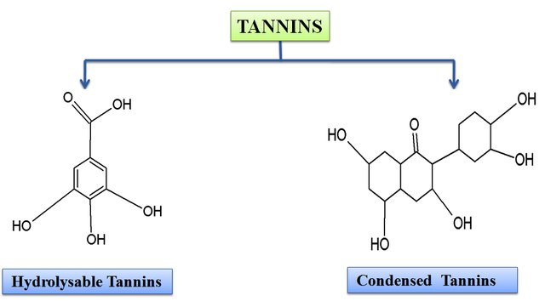
Classes of Tannins
Tannins were classified for the first time in 1922 by Freudemberg, depending on their chemical structures

Slide 6
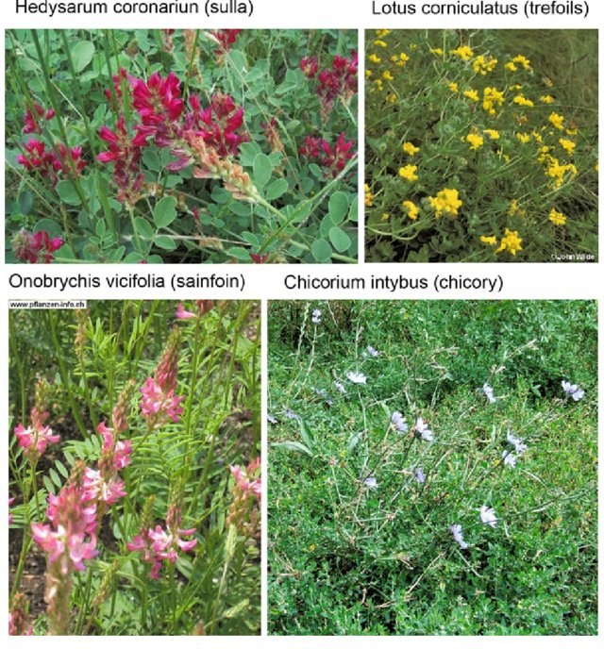
1. Condensed tannins & Proanthocyanidins (such as catechol) are extremely common in nearly all plants. They are flavonoids and anthocyanidin precursors (what gives coloured pigments to plants), and are especially prevalent in fruits, foods, and the Rosaceae family.
The plants rich in condensed tannins used frequently as livestock forage

Slide 7
When taken internally condensed tannins cause precipitation of the cells lining the gut, thus inhibiting cellular secretions and reducing the absorption of substances across the gut wall. This action also leads to reduced sensitivity of nerve endings in the gut, thus reducing peristalsis and making tannins useful in the treatment of diarrhea, especially when due to an infectious cause, as the bacteria in the gut will also be precipitated.

Slide 8
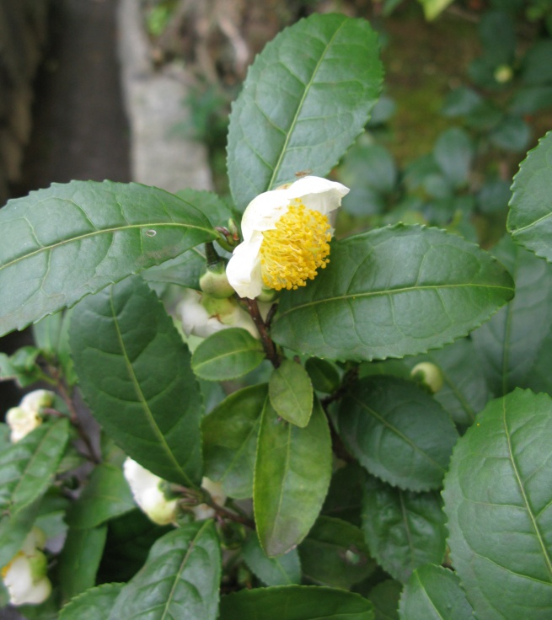
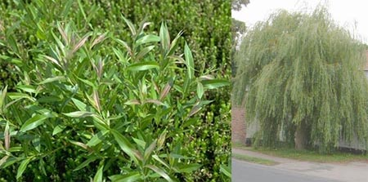
Applied externally they are very useful in treating burns, as they precipitate protein of the exposed tissue to help form a scab. Some herbal examples of condensed tannins include:
Camellia sinensis (Green/Black Tea)
Salix sp. (Willow)
Rubus ideaus (Red Raspberry)
Camellia sinensis
Salix sp.

Slide 9
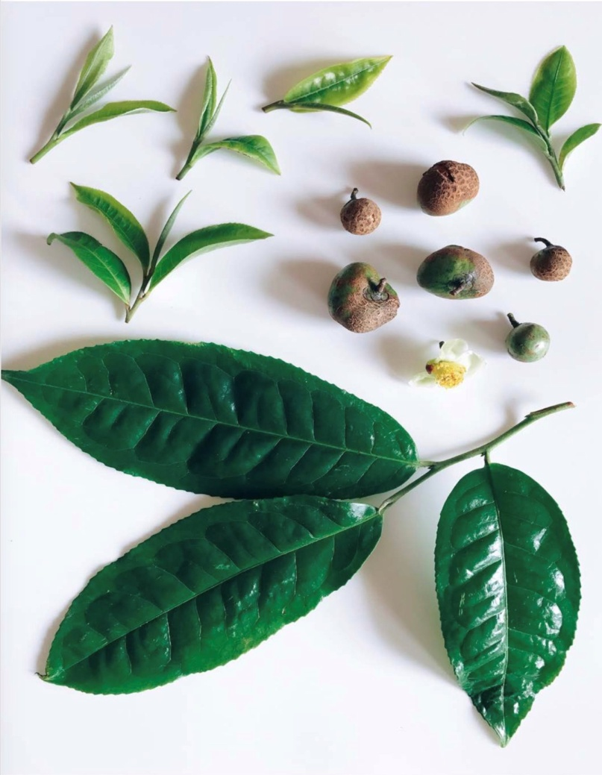
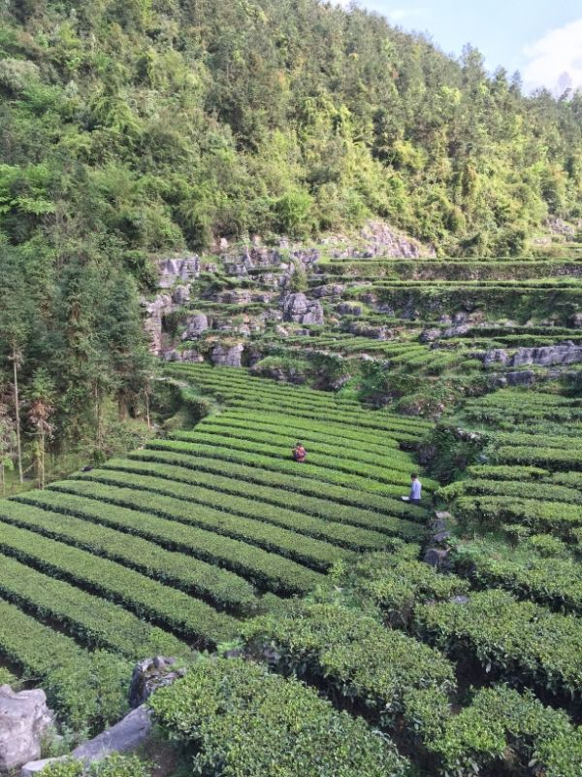
Camellia sinensis
Common name: Green or Black tea
Family: Theaceae
Part used: Leave & buds (black tea uses fermented dried leaves)
Tea plantation

Slide 10
Constituents:
Xanthine alkaloids (caffeine, theobromine, theophylline), polyphenols (catechins, EGCG), Flavonoids, tannins, nutrients, oxalate
Actions:
Nervous system stimulant, antioxidant, diuretic, astringent, anti-bacterial, cardiotonic

Slide 11
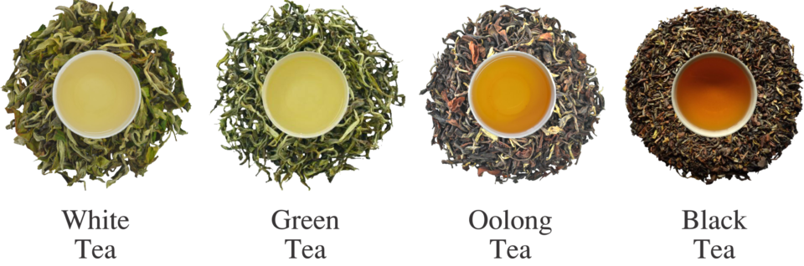
Although tea is generally considered a rich source of tannins, multiple variables can affect the amount that ends up in your teacup.
The four main types of tea are white, black, green, and oolong, all of which are made from the leaves of a plant called Camellia sinensis.
Each type of tea contains tannins, but the concentration is strongly affected by the way it’s produced and how long it’s steeped when you prepare it.

Slide 12
Some sources say black tea has the highest tannin concentration, while green tea is often credited with having the lowest.
White and oolong teas usually fall somewhere in between, but the amount in each type can vary considerably depending on how they’re produced.
Generally, lower-quality teas tend to have higher tannin levels, and the longer you steep your tea, the higher the concentration of tannins in your cup.

Slide 13
Potential health benefits
There are many different types of tannins found in tea, and how they affect the human body is still not well understood.
However, early research suggests that certain tea tannins possess characteristics similar to those of other polyphenols, helping prevent disease by providing antioxidant and antimicrobial benefits.
One of the main tannins found in green tea is known as epigallocatechin gallate (EGCG).

Slide 14
EGCG belongs to a group of compounds known as catechins. It’s thought to be one of the reasons behind the many health benefits associated with green tea.
Animal and test-tube studies suggest that EGCG may play a role in reducing inflammation and protecting against cellular damage and certain chronic illnesses, such as heart disease and cancer.

Slide 15
Theaflavins and thearubigins
Tea also offers a plentiful supply of two groups of tannins called theaflavins and thearubigins. Black teas contain particularly high levels of these tannins, and they’re also credited with giving black teas their distinctive dark color.
At this stage, very little is known about theaflavins and thearubigins. However, early research indicates that they function as potent antioxidants and may offer protection against cellular damage caused by free radicals.

Slide 16
Ellagitannin
Tea also contains high levels of a tannin called ellagitannin.
Early-stage research suggests ellagitannin may promote the growth and activity of beneficial gut bacteria.
Ellagitannin is also in the spotlight for its potential effect on cancer treatment and prevention.

Slide 17
Potential downsides
Although tea tannins provide several health benefits, overconsumption could lead to negative side effects.
Tannins are unique in their ability to easily bind with other compounds. This feature gives tea a pleasantly bitter, dry flavor, but it can also impair certain digestive processes.
Reduced iron absorption
One of the biggest concerns with tannins is their potential ability to hinder iron absorption.
In the digestive tract, tannins can easily bind with iron present in plant-based foods, rendering it unavailable for absorption.

Slide 18
Research indicates that this effect is not likely to cause significant harm in people with healthy iron levels, but it could be problematic for those with iron deficiency.
If you have low iron but want to drink tea, you can limit your risk by avoiding consumption of tea with iron-rich foods.
Instead, consider having your tea between meals.
May cause nausea
The high levels of tannins in tea may lead to nausea if you drink tea on an empty stomach. This may particularly affect people with more sensitive digestive systems.

Slide 19
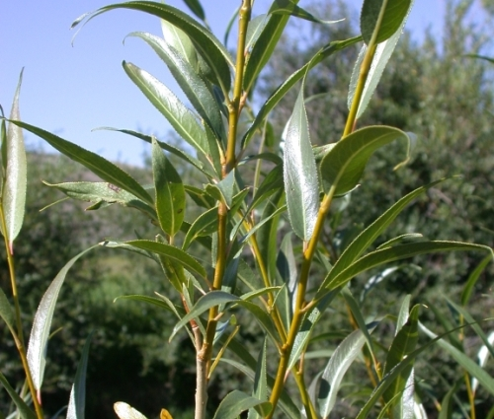
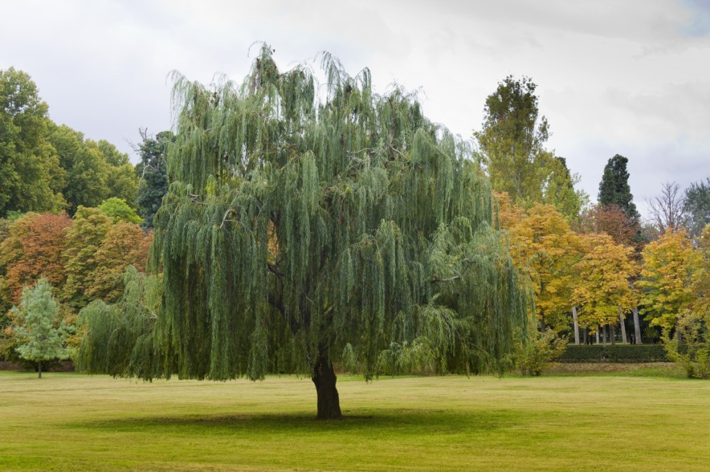
Salix sp.
Common name: Willow
Family: Salicaceae
Parts used: Bark (dried from 2-3 year old branches)

Slide 20
Constituents:
Phenolic glycosides – Salicylates (salicin, salicortin, tremulacin, populin, fragilin, salireposide, trirandrin, vimalin), Aromatic aldehydes and acids (salidroside, vanillin, syringa-aldehyde, syringin, salicylic, vanillic, syringic). Flavonoids (isoquercitrin, naringin), Tannins (8%-20%), catechins, coumaric acid
Medicinal actions:
Analgesic, anti-inflammatory, febrifuge, bitter, astringent, antiseptic, anti-rheumatic

Slide 21
Medicinal use:
Salix sp. is used in a variety of conditions with symptoms of fever and pain. It’s analgesic effects are slower than that of aspiring, but of longer duration and without the gastric side effects. Mild flus and colds with fever, mild headaches and other pain caused by inflammation are indications for this plant. Salix sp. has been used for various forms of arthritis for centuries and is specific for other systemic connective tissue conditions with inflammatory changes.

Slide 22
Conditions with inflammation pain such as anyklosing spondylitis, gout, muscular rheumatism, joint pain, osteoporosis, tendinitis, sprains, sciatica and neuralgia it can be of great use. It should be noted that the irreversible inhibition of platelet aggregation seen with aspirin cannot be induced by Willow.

Slide 23
Pharmacology:
Inhibition of cyclooxygenase accounts for anti-inflammatory, anti-pyretic, and analgesic effects.
Salicin is analgesic & anti-inflammatory. Is metabolized to saligenin in the bowels, then absorbed and metabolized to salicylic acid, which is has aspirin-like effects without irritating the gastric lining.
Salicylates and also uricosuric and promote blood clotting time and plasma albumin binding.

Slide 24
Pharmacy: Dried bark: 1-3 g, TID (the effective dose of salicin is 60-120 mg/day). Decoction: 2-3 g/cup, simmer 20 min, TID. Tincture (1:5, 25%), 5-8ml TID.
Toxicity: Side-effects are not expected when using the whole plant. High doses may cause gastric & renal irritation. Persons with known hypersensitivity to salicylates may experience a reaction (urticaria, rhinitis, asthma, bronchial spasms).

Slide 25
Contraindications: Avoid in children with the flu due to Reye’s syndrome (theoretical)
Interactions: Avoid while using aspirin or other salicylate containing substances, alcohol, barbitutates/sedatives, NSAIDs, anticoagulants, methotrexate, spironolactone, phenytoin, valproate medications.

Slide 26
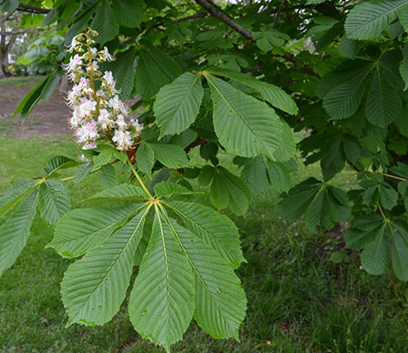
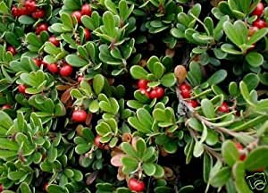
2) Hydrolysable tannins (HTs) are broken down readily by acid, alkali or certain enzymes to yield gallic or ellagic acid, and ultimately pyrogallol which is antiseptic, caustic and hepatotoxic. Thus, HTs should be used with caution and if taken internally it should be for the shortest time possible. Some herbal examples of hydrolyzable tannins include:
Arctostaphylos uva-ursi (Bearberry)
Aesculus hippocastanum (Horsechestnut)
Hamamelis virgininicus (Witch Hazel)
Quercus sp. (Oak)
Arctostaphylos uva-ursi
Aesculus hippocastanum

Slide 27
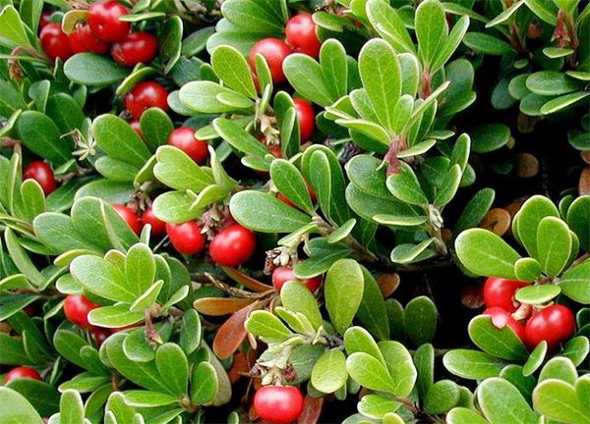
Arctostaphylos uva- ursi
Common name: Bearberry, Uva ursi, Kinnikinnick
Family: Ericaceae
Parts used: Leaves

Slide 28
Constituents:
Hydroquinone glycosides (4-15%): arbutin, methylarbutin. Polyphenols, hydrolyzable tannin, flavonoids (quercetin), resin, acids (ursolic, gallic, ellagic), allantoin, volatile oil (triterpene alkaloids).
Medicinal actions:
Urinary antiseptic, anti-bacterial, astringent, anti-inflammatory, diuretic, tonic, oxytocic, hemostatic, demulcent.

Slide 29
Medicinal use: Is used primarily in the treatment of cystitis, ulcerations of the kidney and bladder, and to soothe and tonify these organs. Apart from its value in removing excess water from the body, it has a specific antiseptic and astringent effect upon the membranes of the urinary system. It will generally soothe, tone, and strengthen them.

Slide 30
Specifically it is used where there is gravel or ulceration in either the kidney or the bladder. It may be used in the treatment of infections, or as part of a holistic approach to more chronic kidney problems. With its high astringency it is used in some forms of bed wetting. As a douche it may be helpful in vaginal ulceration and infection.

Slide 31
Pharmacology:
Hydroquinone derivative, arbutin releases aglycone in alkaline urine with antimicrobial action.
Tannins (hydrolyzable type) are astringent.
Pharmacy: Dry herb: up to 12g QD (equivalent to 400-840 mg arbutin) as infusion or cold macerate. Tincture: (1:5, 25%), 2 – 4 ml TID. Pulse dosing required (2 weeks max). Douche or topical wash.

Slide 32
Contraindications:
Artostaphylos should be avoided during pregancy due to an oxytocic effect. Considering the tannin content, use should be avoided in organic kidney disease. Avoid use for longer than 14 days consecutively.

Slide 33
Toxicity: The toxicology is proportional to the conversion of arbutin to hyrdroquinone as hydroquinone is a highly toxic and mutagenic. 15 g of the fresh leaves can provide 1 g of hydroquinone which can be toxic with signs and symptoms of: tinnitus, nausea, vomiting, sense of suffocation, shortness of breath, cyanosis, convulsions, delirium and collapse. Caution due to hydrolyzable tannin content.
Interactions: None known.

Slide 34
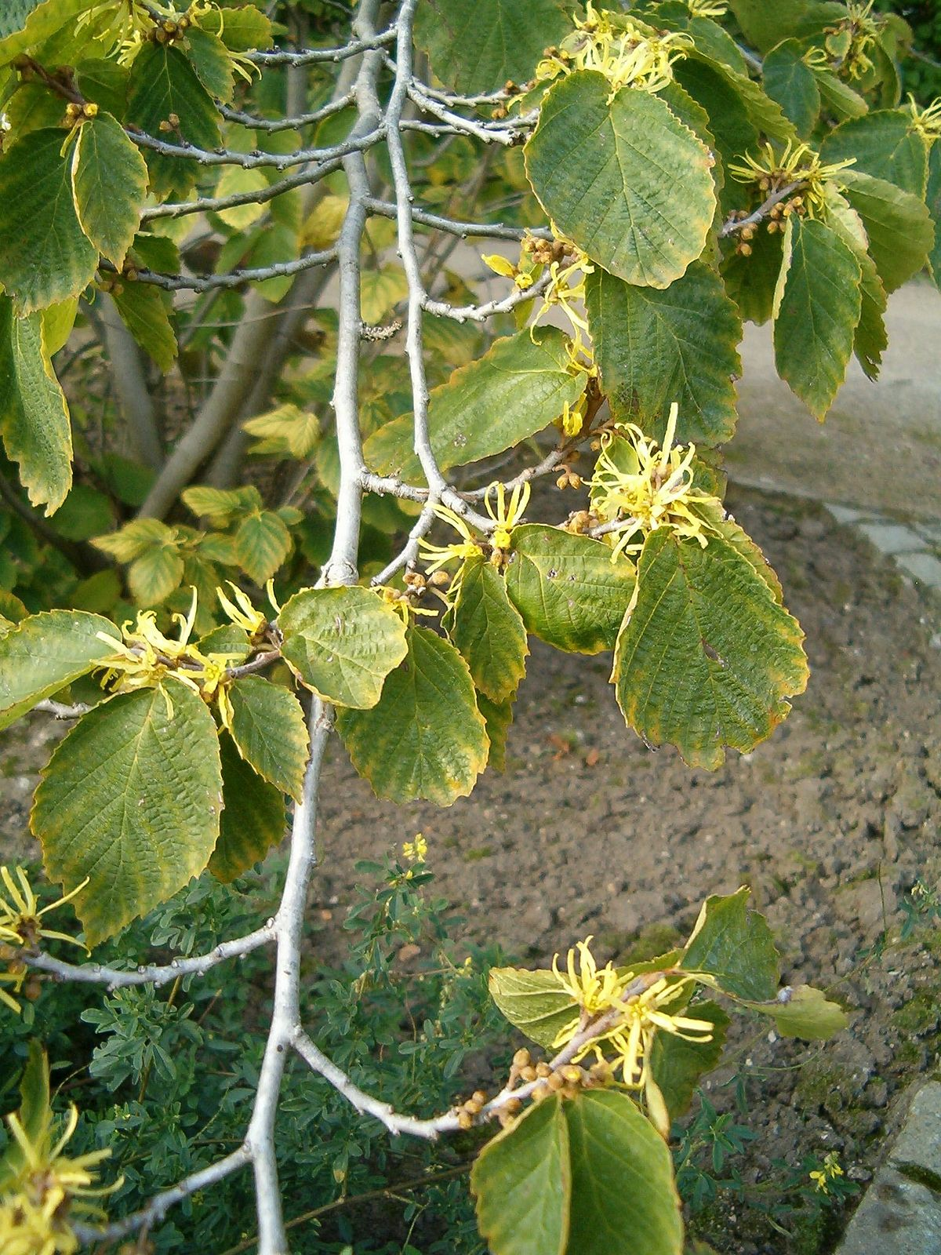
Hamamelis virginiana
Common name: Witch Hazel
Family: Hamameliadaceae
Parts used: Leaves, Bark

Slide 35
Constituents:
Leaves: Tannins (hydrolyzable gallotannins & condensed catechins and proanthocyanin), flavonoids, quercitin.
Bark: Tannins (hydrolyzable hamamelitannins & condensed d-gallocatechin, l-epigallocatechin, l-epicatechin), saponins, resin.
Medicinal actions:
Astringent, anti-inflammatory

Slide 36
Medicinal uses:
Should only be used topically for the treatment of hemorrhoids, varicose veins, bruises and inflamed swellings & skin disorders (eg. eczema, dermatitis). If used in a vaginal douche, it will address purulent mucus discharge from inflamed tissues as well as blood loss. It’s antioxidant activity can be useful towards anti-aging and anti-wrinkling of the skin.

Slide 37
Pharmacology:
Tannins (Hamamelitannin) demonstrated in vitro antioxidant activity and protected murine skin fibroblasts from damage induced by UVB irradiation, and human experiments have demonstrated suppression of UVB mediated sunburn with topical application of Hamamelis lotion.
Topical application of leaf extract produces a significant reduction in skin temperature and vasoconstrictive activity.
Hamamelis concentrate exhibited significant antiviral activity against herpes simplex virus type 1 in vitro.

Slide 38
Pharmacy:
Distilled witch hazel water for topical application.
Cream, Poultice, Compress etc.
Toxicity: Hydrolysable tannins which are broken down easily by acid, alkali or certain enzymes to yield gallic or ellagic acid, and ultimately pyrogallol which is antiseptic, caustic and hepatotoxic. Thus if taken internally it should be for the shortest time possible.
Contraindications: Internal use (relative) due to hydrolyzable tannins.

Slide 39
Interactions:
When extracted in hot water, tannins can precipitate alkaloids from plants, drugs, proteins, salicylates, iodine, metals, minerals and B vitamins thereby slowing, reducing or blocking their absorption. The drug-tannin reaction can interfere with dosing if sources of the two compounds are combined in solution prior to administration.

Slide 40
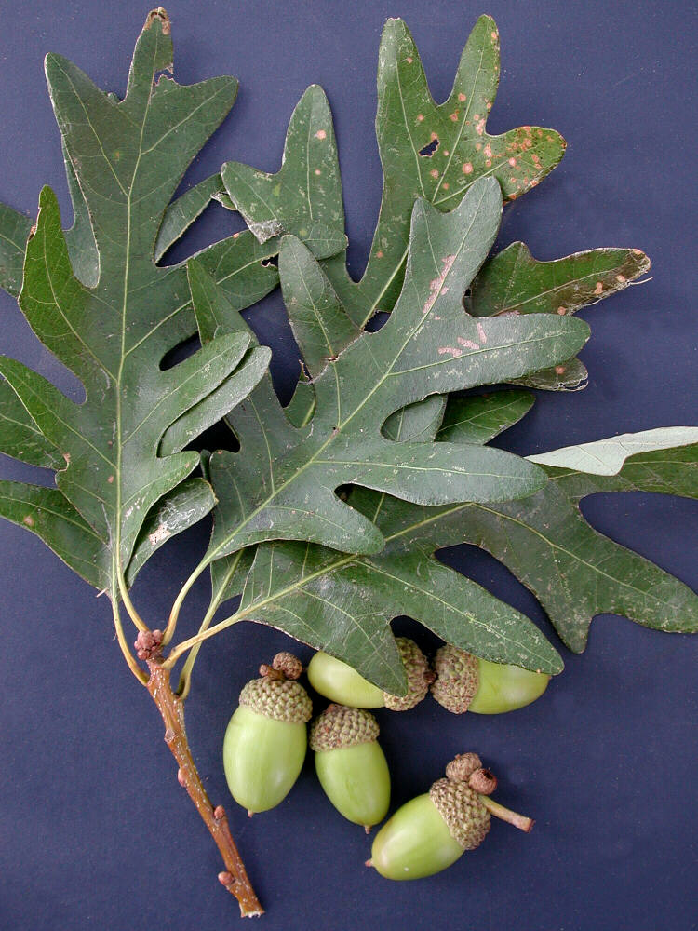
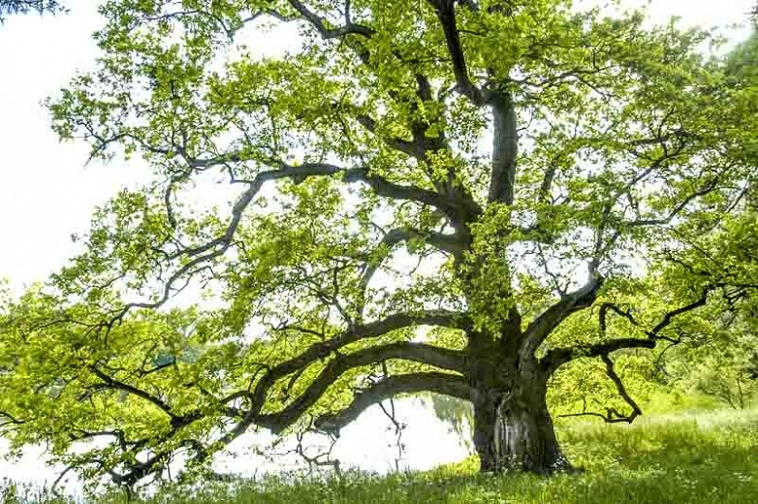
Quercus alba
Common name: White oak
Family: Fagaceae
Part used: Bark

Slide 41
Constituents:
Tannins (up to 15-20% consisting of phlobatannin, ellagitannins, and gallic acid)
Medicinal actions:
Astringent, hemostatic, antiseptic
Pharmacy:
Decoction 1 tsp/cup; 1 cup TID. Tincture: (1:5), 1-3 ml TID. Powder: 1-2 g TID.

Slide 42
Medicinal use:
Quercus is used in the treatment of pharyngitis as a gargle, in the treatment of diarrhea as tea or tincture, and in the treatment of hemorrhoids as an enema, suppository, or compress. Quercus is a strong astringent and antiseptic and a mild tonic to the tissues which it contacts.

Slide 43
Tannins & Tissue Specificity
Tannins also demonstrate the amazing phenomenon of tissue specifity, whereby their astringent action may act locally, or at a distant site within the body. Astringent Herbs with tissue specificity to various body systems may include:
Hemostatics:
Achillea millefolium (Yarrow)
Aesculus hippocastanum (Horeschesnut)
Capsella bursa-pastoris (Shepard’s Purse)
Hamamelis virginicus (Witch Hazel)

Slide 44
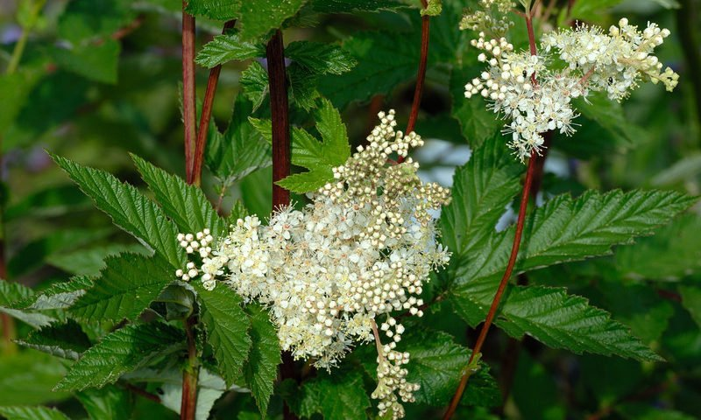
Filipendula ulmaria
Common name: Meadowsweet
Family: Rosaceae
Parts used: Aerial

Slide 45
Constituents:
Volatile oil: polyphenol components (salicylates – salicin, salicylic acid), flavonoids, tannins, coumarins, mucilage, ascorbic acid
Medicinal actions:
Antiseptic, analgesic, anti-inflammatory, astringent, diaphoretic, anti-coagulant, antacid, carminative, anti-emetic, digestive, hepatic, diuretic, anti-rheumatic

Slide 46
Medicinal use:
Has specific use for peptic ulcers both as prophylactic and as treatment. Regulates gastric acid levels and protects and soothes GIT mucous membranes. Also of great use in musculoskeletal conditions such as arthritis, gout, and all kinds of muscle & joint pains. It promotes uric acid excretion and has anti-bacterial and immunomodulating effects.
Pharmacology:
Salicylates – salicin, salicylic acid are analgesic and anti-inflammatory.

Slide 47
Pharmacy: Powder: 2-4g, TID. Capsules: 500mg, BID. Infusion: 2 tsp/cup, TID. Tincture: (1:2, 60%), 3-6ml QD.
Contraindications: Allergic to salicylates or aspirin. Caution in asthma due to possibly bronchospastic effects.
Toxicity: No adverse effects expected.
Interactions: Theoretically may interfere with anticoagulants.

Slide 48
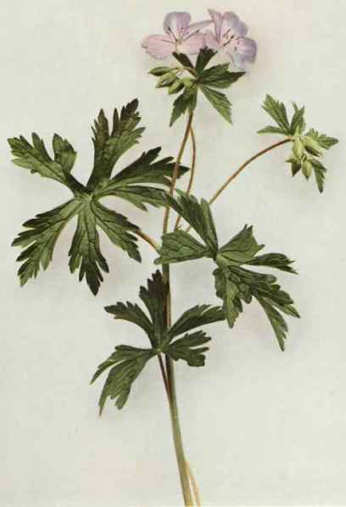
Germanium maculata
Common name: American cranesbill
Family: Geraniaceae
Parts used: Root & aerial

Slide 49
Constituents:
Tannins (up to 30%) inc. gallic acid; Resinous compounds.
Medicinal actions:
Styptic, astringent, vulnerary, tonic
Medicinal uses:
Geranium is an astringent, also hemostatic. Relaxed mucous tissues with profuse debilitating discharges; chronic mucous diarrheas; chronic dysentery; diarrhea with constant desire to defecate; passive hemorrhages; gastric ulcer.

Slide 50
Pharmacy:
Decoction: 1-2 tsp/cup; simmer 10-15 min, 1 cup TID. Tincture: (1:5, 25%), 2-4 ml TID; weekly maximum is 60 ml.
Toxicity:
Safe herb, however use with caution in people with spastic, dry constipation or people taking anticholinergic medication as it will potentiate smooth muscle irritability.

Slide 51
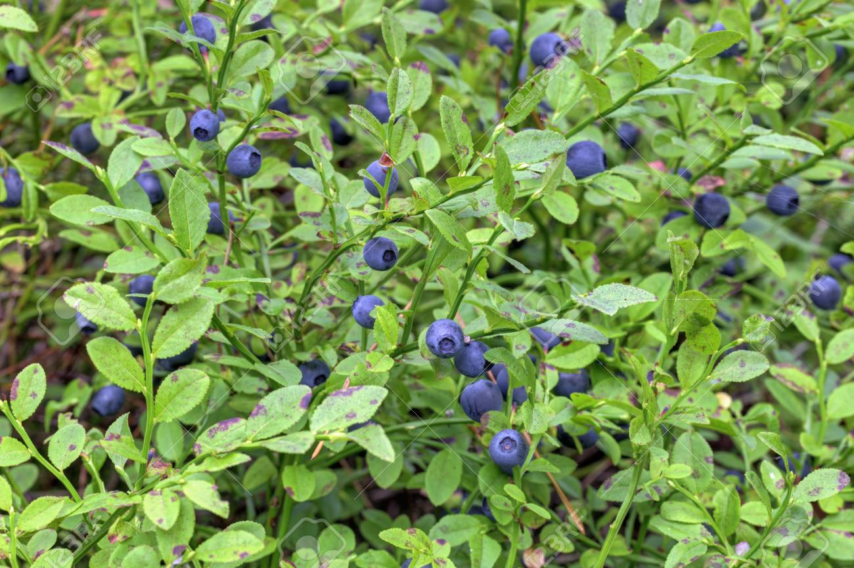
Vaccinium myrtillus
Common name: Blueberry, Bilberry
Family: Ericaceae
Part used: Berry/fruit, leaf

Slide 52
Constituents:
Flavonoids: anthocyanosides, tannin (7%), polyphenols (catechin, epicatechin), nutrients (Vitamin B1, C, beta carotene), pectin
Medical actions:
Anti-inflammatory, astringent, diuretic, antioxidant, anti-microbial, anti-edematous, venous tonic, vaso-protector, anti-platelet, anti-emetic, anti-diarrheal

Slide 53
Medical uses:
Is indicated in visual disturbances/poor vision, retinopathy, cataracts and macular degeneration, as well as retinitis pigmentosa, diabetic retinopathy, and night-blindness. Used in the prevention and treatment of glaucoma. The antioxidant effects make Vaccinium useful in gout and rheumatoid arthritis. It is useful for venous insufficiency (especially in the legs), hemorrhoids, varicose veins and capillary fragility as a whole.

Slide 54
Bilberries have been used as food and for their high nutritive value. Medicinally, they have been utilized in the treatment of scurvy and urinary complaints (including infection and stones). The dried berries have been used primarily for their astringent qualities. in the treatment of diarrhea and dysentery. Decoctions of the leaves have been used in the treatment of diabetes.

Slide 55
Pharmacology:
Anthocyanins are antioxidant and blood vessel tonics which help to stabilize collagen and protect it during inflammation.
Over 15 different anthocyanosides originate from the five different anthocyanidins found in bilberry.

Slide 56
Pharmacy: Standardized extract (25% anthocyanosides): 80-160 mg TID. Fresh berries: 2-4 oz. TID. Decoction, as a mouthwash or tea: simmer 3 tbsp in ½ Liter of water for 10 min, drink throughout the day. Tincture: (1:1, 25%), 3-6ml QD.
Contraindications: Caution in hemorrhagic disorders.
Toxicity: None reported.
Interactions: Anti-coagulant medication (theoretical).

Slide 57
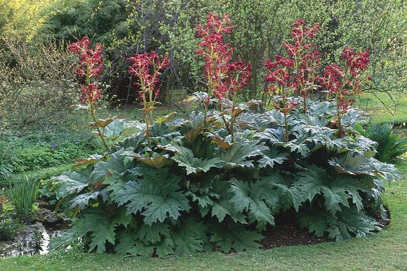
Rheum palmatum
Common name: Turkey rhubarb
Family: Polygonaceae
Parts used: Rhizome

Slide 58
Medicinal actions:
Bowel tonic (mild stimulant laxative), astringent, aperient, sialogogue
Constituents:
Anthraquinone glycosides including emodin, tannins, stilbene derivatives, volatile oil, rutin, fatty acids, calcium oxalate.

Slide 59
Medicinal use: Rheum palmatum is used for its laxative effects. Rheum is indicated in atonic constipation or diarrhea secondary to lack of tone. Rheum has an antiseptic action.
Pharmacy: Rhubarb powder: 0.5-5g/day. Decoction: 1 tsp/cup; 1 cup TID. Tincture (1:5) up to 6 ml/day; 40 ml/week max.
Toxicity: Diarrhea with mild griping; icterus and hepatic enlargement; renal insufficiency and proteinuria.

Slide 60
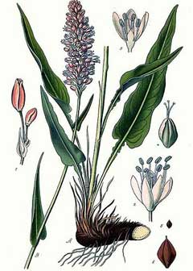
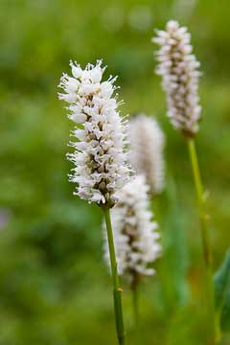
Polygonum bistorta
Common name: European bistort or meadow bistort
Family: Polygonaceae
Parts used: root/rhizome

Slide 61
Constituents:
Bistort root has never been carefully analysed, but it is known to contain about 20 per cent. of tannin and a large amount of starch, as well as some gallic acid and gum. Its virtues are extracted by water and its decoction becomes inky black on the addition of a persalt of iron and with gelatine it forms a precipitate. Red colouring matter is also present.

Slide 62
Medicinal Action and Uses:
Bistort root is one of the strongest astringent medicines in the vegetable kingdom and highly styptic and may be used to advantage for all bleedings, whether external or internal and wherever astringency is required. Although its use has greatly been superseded by other astringents of foreign origin, it is of proved excellence in diarrhoea, dysentery, cholera and all bowel complaints and in haemorrhages from the lungs and stomach, and is a most effectual remedy for bleeding from the nose and exceedingly useful in dealing with haemorrhoids. It is used - as a medicine, injection and gargle - in mucous discharges, as well as for haemorrhages.

Slide 63
Pharmacy:
the powdered root, a teaspoonful in a cupful of boiling water, may be drunk freely as requiredm; decoction: internally and externally, as a poultice; a fluid extract.
Bistort is considered valuable for diabetes, given in conjunction with tonics, and has itself tonic action.

Slide 64
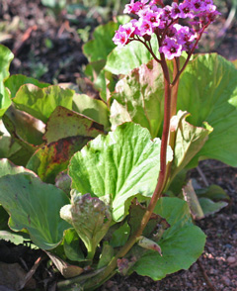
Bergenia crassifolia
Common name: Leather Bergenia
Family: Saxifragaceae
Parts used: Leaf and root/rhizome.

Slide 65
Chemical constituents: Rhizome contains tannins, phenol carboxylic acids and their derivatives, (+)-catechin and catechin gallate, isocoumarin: bergenin.
Leaves contain 6–30% tannins, 12.18% arbutin, hydroquinone, rododendrine, pectin: bergenan, catechin: gallocatechin, catechin gallate, flavonoids: quercetin, kaempferol, leucoanthocyanidin: leucocyanidin, leucdelifinidin, coumarin: ellagic acid, isocoumarin: bergenin
Bioactivities:
Anti-inflammatory, antibacterial, anti-ulcerous, antidiarrheal.

Slide 66
Medicinal use:
stimulates the body's immune system and reduces the risk of developing diseases of the cardiovascular system. extract has pronounced anti-inflammatory, antibacterial and diuretic effects. Normalizes the functional activity of the gastrointestinal tract, cardiovascular and genitourinary system. Normalizes high blood pressure. For external use, ointments accelerate the healing of injuries and hematomas, relieve inflammation and swelling, improve blood microcirculation, stimulate tissue regeneration and have a pronounced anti-inflammatory and antibacterial effect in skin diseases.

Slide 67
Contraindications:
individual intolerance, allergic reaction, pregnancy, breastfeeding, constipation, thrombosis, increased blood clotting, hypotension, tachycardia.

Slide 68
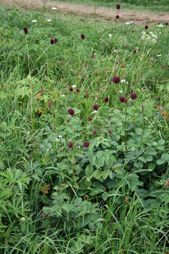
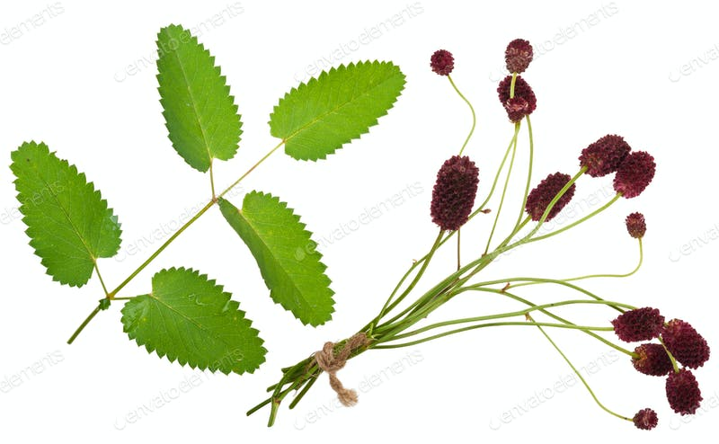
Sanguisorba officinalis
Common name: Great burnet
Family: Rosaceae
Parts Used: The rhizomes, roots and the fresh or dried aerial parts of the herbs have been used in herbal medicine.

Slide 69
Constituents:
The main substances found in great burnet are flavonoids, saponins, ursolic acid, arabinose, essential oil, vitamin C, and tannins. The rhizomes of great burnet contain a high amount of tannins (up to 17% ) which are responsible for the astringent, antiseptic and anti-inflammatory properties of the herb.

Slide 70
Medicinal actions:
Astringent and tonic. Great Burnet was formerly in high repute as a vulnerary, hence its generic name, from sanguis, blood, and sorbeo, to staunch. Both herb and root are administered internally in all abnormal discharges: in diarrhoea, dysentery, leucorrhoea, it is of the utmost service; dried and powdered, it has been used to stop purgings.
The whole plant has astringent qualities, but the root possesses the most astringency. A decoction of the whole herb has, however, been found useful in haemorrhage and is a tonic cordial and sudorific.

Slide 71
Medicinal use: Great burnet is employed mainly for its astringent action, being used to slow or arrest blood flow. It is taken both internally and externally internally and is a safe and effective treatment. Modern research in China has shown that the whole herb heals burns more effectively than the extracted tannins (the astringent component of the plant). Patients suffering from eczema showed marked improvement when treated with an ointment made from the root and petroleum jelly. The leaves are astringent, refrigerant, styptic and tonic. They are used in the treatment of fevers and bleeding.

Slide 72
The root is anodyne, astringent, diuretic, febrifuge, haemostatic, tonic and vulnerary. It is used in the treatment of peptic ulcers, haematuria, menorrhagia, bloody stool, dysentery, diarrhoea, haemorrhoids and burns.
All parts of the plant are astringent, but the root is most active. Great burnet is an excellent internal treatment for all sorts of abnormal discharges including diarrhoea, dysentery and leucorrhoea. It is used externally in the treatment of burns, scalds, sores and skin diseases.

Slide 73
Contraindication:
No side effects or contraindications have been indicated when great burnet has been used as a medicinal herb but due to the lack of data on the pharmacological effects and toxicity of the plant, it should not be used by women who are breastfeeding or during pregnancy.
Because of the high content of tannins the herb should not be used continuously over a long time.

